Slide 1


Real time Data Ingestion and Transformation Pipeline with AWS, Snowflake, and Airflow
Team Details – StreamLine:
Vishnu Vardhan Ciripuram (vc2499)
CS-GY 6513: Big Data Prof. Juan Rodriguez

Slide 2
Problem Statement & Goal
Deliver latest operational data from edge systems to Snowflake within 1 minute.
Replace ETL with streaming micro‑batch architecture.
Maintain auditability, cost‑efficiency, and cloud‑native manageability.

Slide 3
AWS Components
Amazon EC2 (t2.micro) – synthetic data producer.
Kinesis Data Firehose – managed streaming buffer.
Amazon S3 – three‑zone data lake (Landing / Processing / Processed).
Amazon MWAA (Airflow 2.10) – orchestration and scheduling.

Slide 4
Snowflake Components
External Stage (S3_INTEGRATION_IM) with scoped IAM role.
Raw tables: CUSTOMER_RAW & ORDERS_RAW (+BATCH_ID).
Mart: ORDER_CUSTOMER_DATE_PRICE (aggregated fact).
Warehouse: IM_CURATION (X‑SMALL, auto‑suspend).

Slide 5
End‑to‑End Architecture
EC2 + Kinesis Agent streams CSV events.
Amazon Kinesis Data Firehose buffers & writes to S3 Landing.
Airflow DAG (MWAA) detects objects → moves Landing→Processing→Processed.
Snowflake COPY INTO loads raw tables; SQL transform builds a mart.

Slide 6
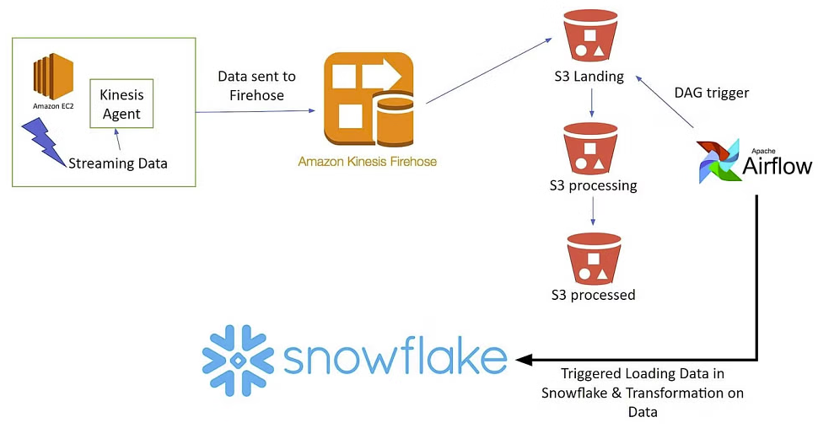
Architecture

Slide 7
Demo
Real time Data Ingestion and Transformation Pipeline

Slide 8
Airflow DAG Logic
Parametrised by UTC timestamp BATCH_ID.
BashOperators move objects via aws s3 mv.
SnowflakeOperators execute COPY INTO and downstream SQL.
Post‑pipeline notification task completes run.

Slide 9
Data Lineage & Idempotence
Immutable ‘processing/{BATCH_ID}/’ prefix guarantees replayability.
BATCH_ID column stored in all target tables.
Re‑running DAG with same BATCH_ID results in zero additional rows.

Slide 10
Security & IAM
EC2 instance profile: AmazonKinesisFirehoseFullAccess + CW logs.
MWAA execution role: least‑privilege S3 and secret access.
Snowflake storage integration limited to firehouse/ prefixes.
End‑to‑end TLS; credentials stored in Secrets backend.

Slide 11
Performance Results
Mean end‑to‑end latency: 35 s (5 MiB micro‑batches).
Throughput: 2 MB/s (limited by t2.micro network).
Snowflake warehouse avg CPU < 40 %.
Cost footprint: <5 USD / month at test volume.

Slide 12
Business Value & Use‑Cases
Near‑real‑time revenue dashboards (order totals by minute).
Fraud/anomaly detection on streaming orders.
Unified customer 360 lake‑house without bespoke ETL servers.
Scalable pattern reusable for additional domains.

Slide 13
Future Enhancements
CI/CD for DAGs via AWS CodePipeline.
Schema‑on‑read with Snowflake auto‑detection or Parquet.
Integration with dbt Core for model lineage.
Switch Firehose to MSK Connect for exactly‑once semantics.

Slide 14
Problems Encountered
Permission Issues: Initial IAM roles and policies must be correctly scoped, resulting in permission denials.
Dependency conflicts in Airflow were resolved by meticulous package management.
Ensure correct batch tracking and transformations by carefully debugging SQL scripts and Airflow logic.

Slide 15

Thank You!
Any Questions?

Slide 16
References
AWS - Kinesis Data Firehose Developer Guide (2024): https://docs.aws.amazon.com/firehose/latest/dev/firehose-dg.pdf
Snowflake Inc. - Best Practices for Data Loading (2024): https://docs.snowflake.com/en/user-guide/data-load-considerations
T. Armbrust et al. - Delta Lake: High-Performance ACID Table Storage (VLDB 2019):
https://www.vldb.org/pvldb/vol13/p3411-armbrust.pdf Di Tommaso, P. - Nextflow for Cloud-Scale Workflow Orchestration (Nature Biotechnology 2019)†:
https://www.nature.com/articles/nbt.3820

